Slide 1

A data science perspective on how meteorology correlates to air pollution
Matthias Baumann, Aurelio Negri, Linus Vogel, Gilles Waeber

Slide 2
Introduction: A brief introduction to PM
Small atmosphere particles.
Linked to many health problems. [1] Limits enforced in Switzerland since 1986. [2]
Suspended particulates | Density | Average
PM10 | 20 μg/m³ | Annual average
 | 50 μg/m³ | 24-hour mean; once a year
PM 2.5 | 10 μg/m³ | Annual average
Notes:
Sources: https://en.wikipedia.org/wiki/Particulates#Size_distribution_of_particulates, https://www.fedlex.admin.ch/eli/cc/1986/208_208_208/en#annex_7/lvl_d2775e432

Slide 3
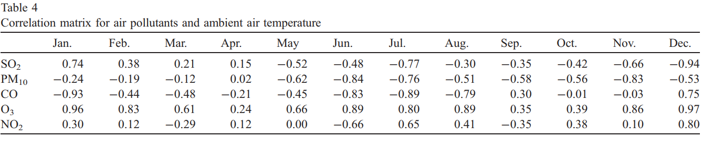
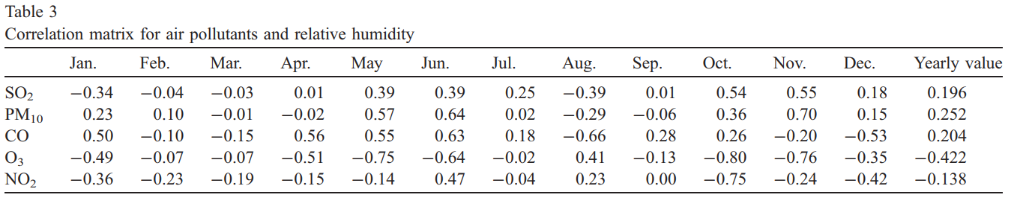
Introduction: Correlation between meteorology and PM
Wind direction and intensity.
Season dependent as well. Studies in different regions (Dhaka and Cairo). [3][4]
Notes:
Source: https://www.sciencedirect.com/science/article/abs/pii/S0048969705000732

Slide 4
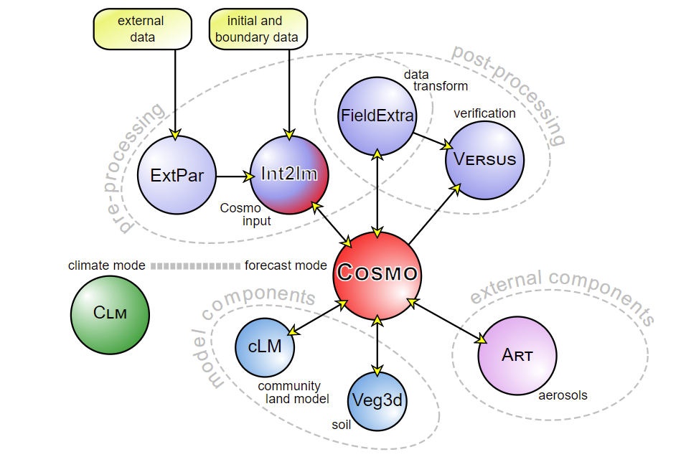
Introduction: Correlation between meteorology and PM
Swissmeteo in collaboration with Center for Climate Systems Modeling. [5]
Big focus on climate models and spatial resolution.
A wide use of indicators to predict long term pollution. [6]
Day to day forecasts still rely on numerical models. COSMO model shared between various countries.
[7]

Slide 5
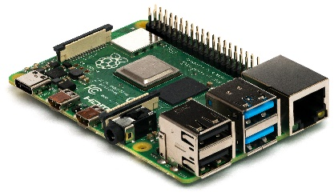


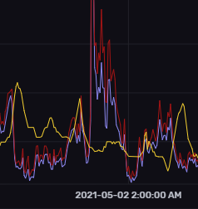
Data pipeline
Data
Img. Ref. commons.wikimedia.org
Notes:
Our research target was to create an data pipeline capable of acquire, storing and managing, training and predicting and then presenting current values and predictions.

Slide 6

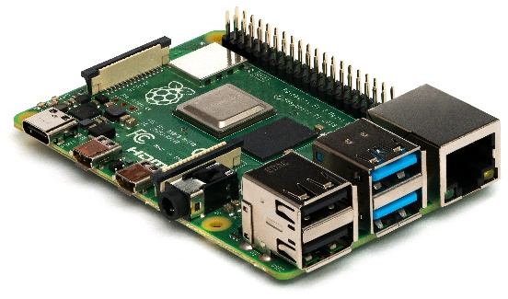
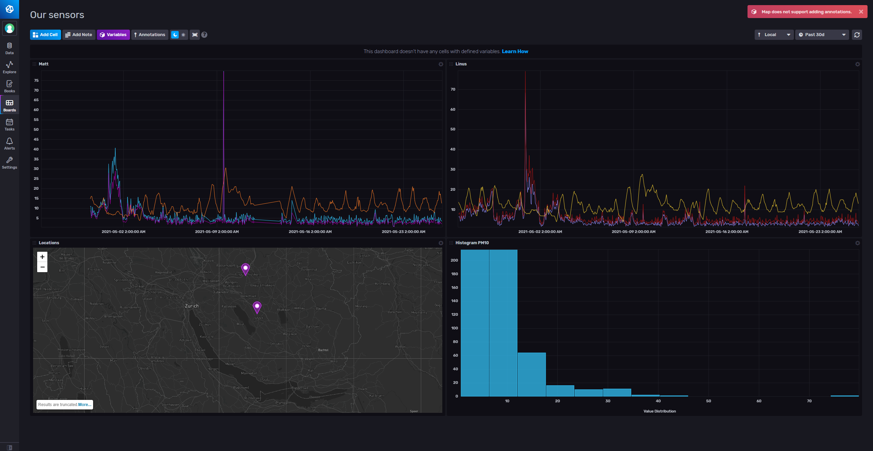




Aimed Architecture
Notes:
We then approached this with the following software architecture: Very early in our research project we aimed for a globally-available cloud-based SaaS time-sequence database architecture, where each component location-independently communicates over the internet.
On the left we’ve our self-made weather/pollution acquisition system, which streams the current observations continously to the database. The self-written keras-based prediction software then downloads the most current data and makes a prediction. Also, we have a dashboard showing the current data.

Slide 7
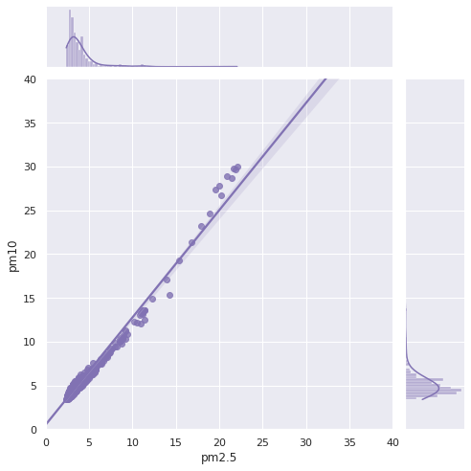
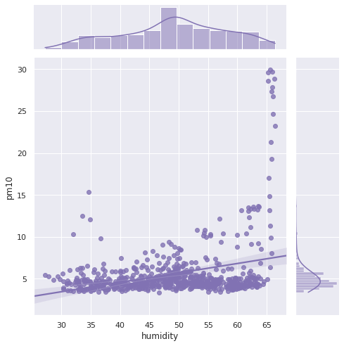
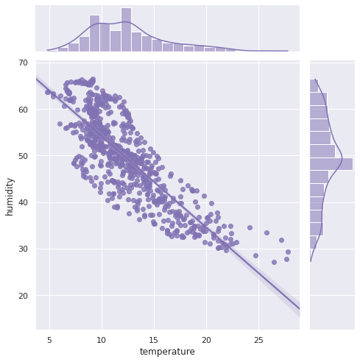
Analysis of input data
Notes:
We’ve started our research by finding correlations in the firstly acquired data. We’ve found very strong correlations between pm series, e.g. for pm2.5 and pm10, and between temperature and humidity. Between pm10 and humidity it is not possible to see a correlation right away.

Slide 8
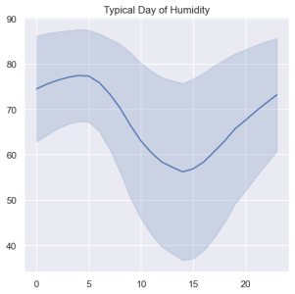
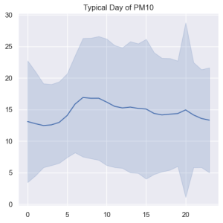
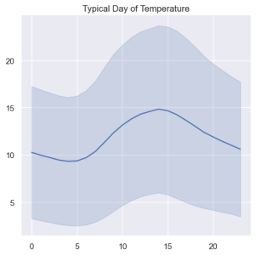
A typical day this spring
A hue of value differences in humidity, pm10, temperature
Notes:
A hue symbolizing the difference in day progressions on all days this spring. As we can see the PM10 value does not follow from humidity or temperature except of our suspicion that PM10 is a bit lower when humidity is high as this might be that at this time very liddle wind is blowing therefore PM10 low and humidity high.

Slide 9
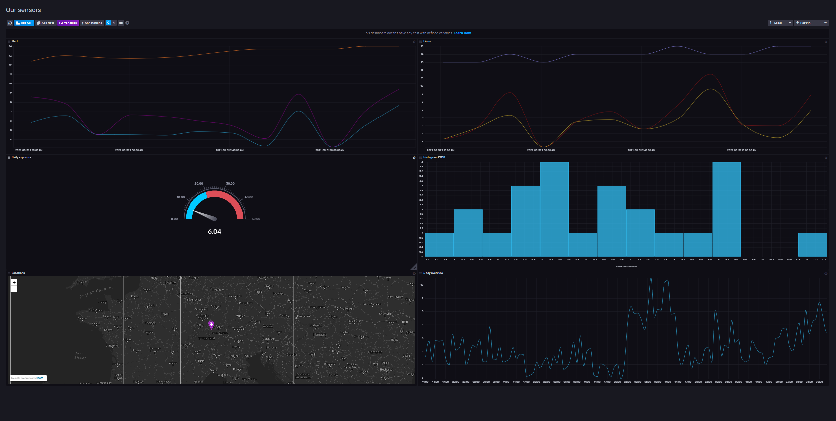
Acquisition/dashboarding the data
Notes:
As a result, we can show our data in an interactive dashboard online.

Slide 10
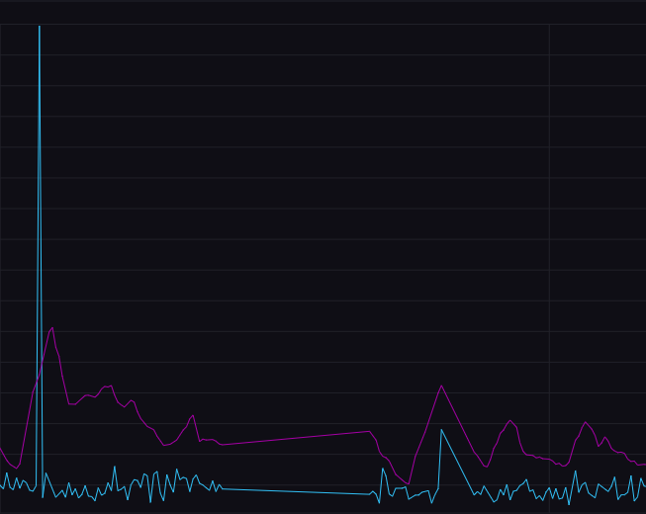
Analyzing the data
In Analysis of our acquired data, we found:
Outliers
Gaps
Noise
Notes:
Further analysis showed that our data also contains a sizable number of outliers, short gaps and some noise.
Return to our midterm presentation where we realized that pollen might be a contributing factor to our question of research.
It might be beneficial to add here reasons why intermediary steps now had to be taken to get to the desired result. Because of these very unaccustomed data we had to filter and fill-up s.t. we get ... next slide.
Whilst our analysis the acquired data with the database provided statistical tools, we realized that the data contains multiple errors, we’ve seen outliers, shown here as a peak, gaps in the data-stream, shown as a flat zone, and generally some noise.

Slide 11
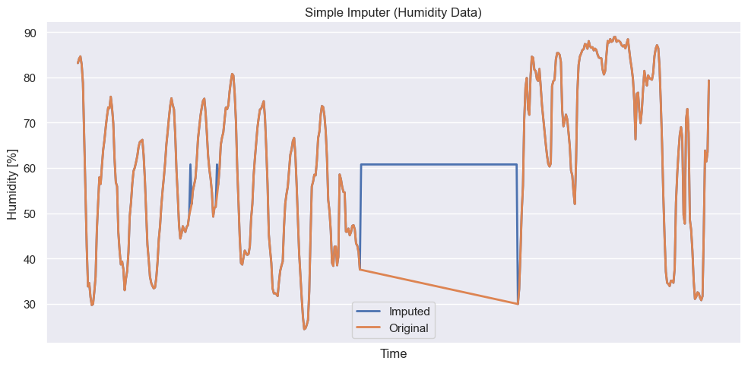
Preprocessing

Slide 12
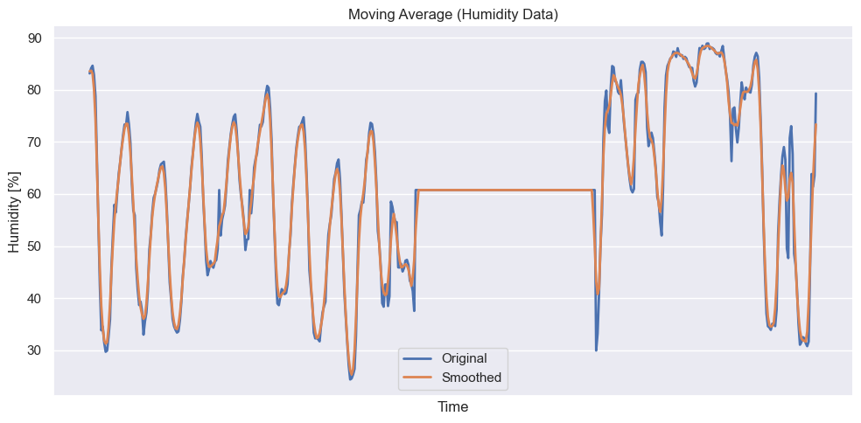
Preprocessing

Slide 13
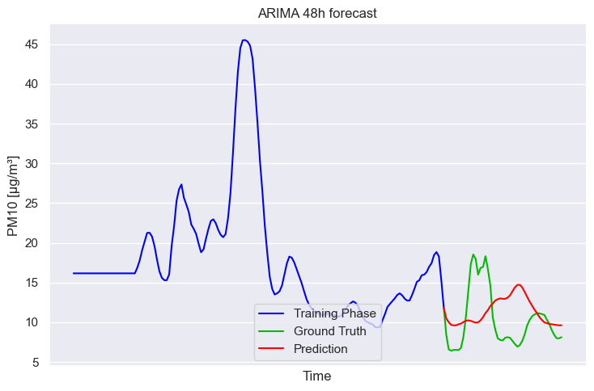
ARIMA model
Notes:
In blue we see the data given into the model, the green line the actual progression and in red the prediction by the model. As it’s obvious, the models does not follow the ground truth.

Slide 14
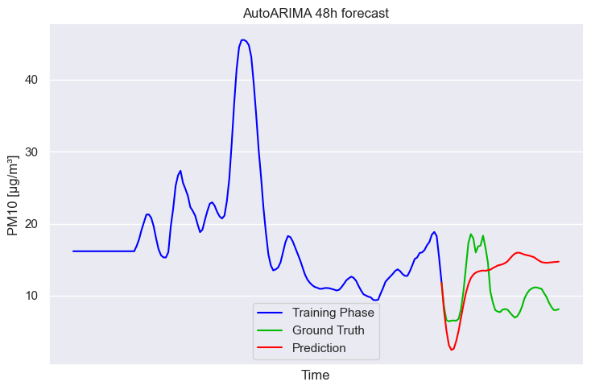
AutoARIMA model
Notes:
We hoped the automatic selection of hyperparameters that AutoArima offers would archieve better performance, yet that only seems to hold for a very short forcasting horizon.

Slide 15
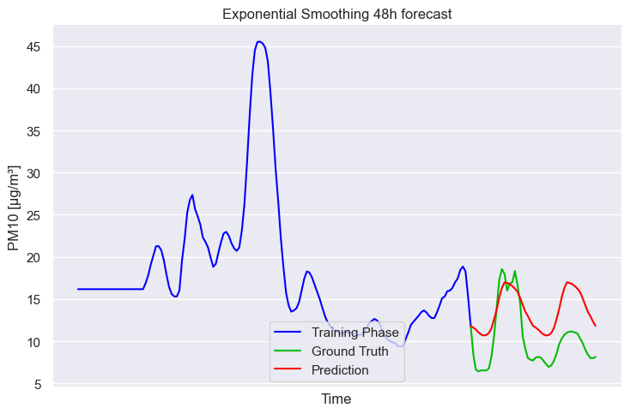
Exponential smoothing model
Notes:
The exponential smoothing model has shown a periodic approximation, but still lacks ability to represent the complexity of the desired output.

Slide 16
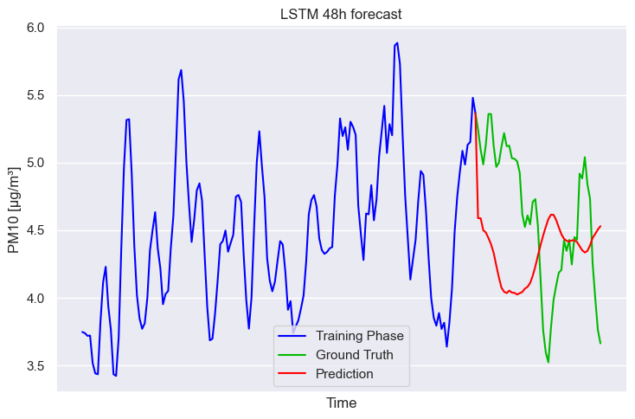
LSTM model
Notes:
The LSTM network beared our hopes for a long time, but when we finally got it up and running, our expectations were not being met, as the model improved efficiency but not as good as expected.

Slide 17
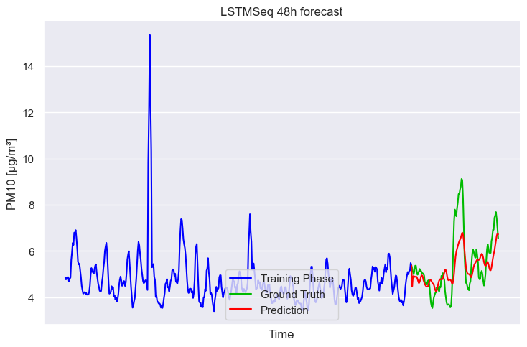
LSTMSeq model
Notes:
This model seems to perform best, however still fails to account for big spikes.
The models give acceptable approximates, which are most likely good enough to show basic trends, but would not constitute to a progression forecast, as farmers for example, need as best fitting progressions as possible.

Slide 18
Comparing performance
RMSE Arima | 1.57
RMSE AutoArima | 1.50
RMSE ExpSmoothing | 1.37
RMSE LSTM | 1.36
RMSE LSTM.Seq | 0.94
Collective | 1.48
Notes:
On the left you can see the predictions of Arima, AutoArima, ExpSmoothing and LSTM versus the real progression in blue. As you can see, most models more or less predict a flat line, which is why the exp smoothing has the smallest root-mean-square error, that is a measure of deviation from the real curve, as it is the least times contrary to the real curve.
We have then tried to take AutoArima, Arima, ExpSmoothing and LSTM into a compound prediction by taking average of their respective curves. Which obviously gives an RMS Error in the middle of the others.
By and large, we’ve found that the LSTM.Seq produces the best predictions, as the curve follows somewhat the real curve and has a acceptable RMS value.

Slide 19
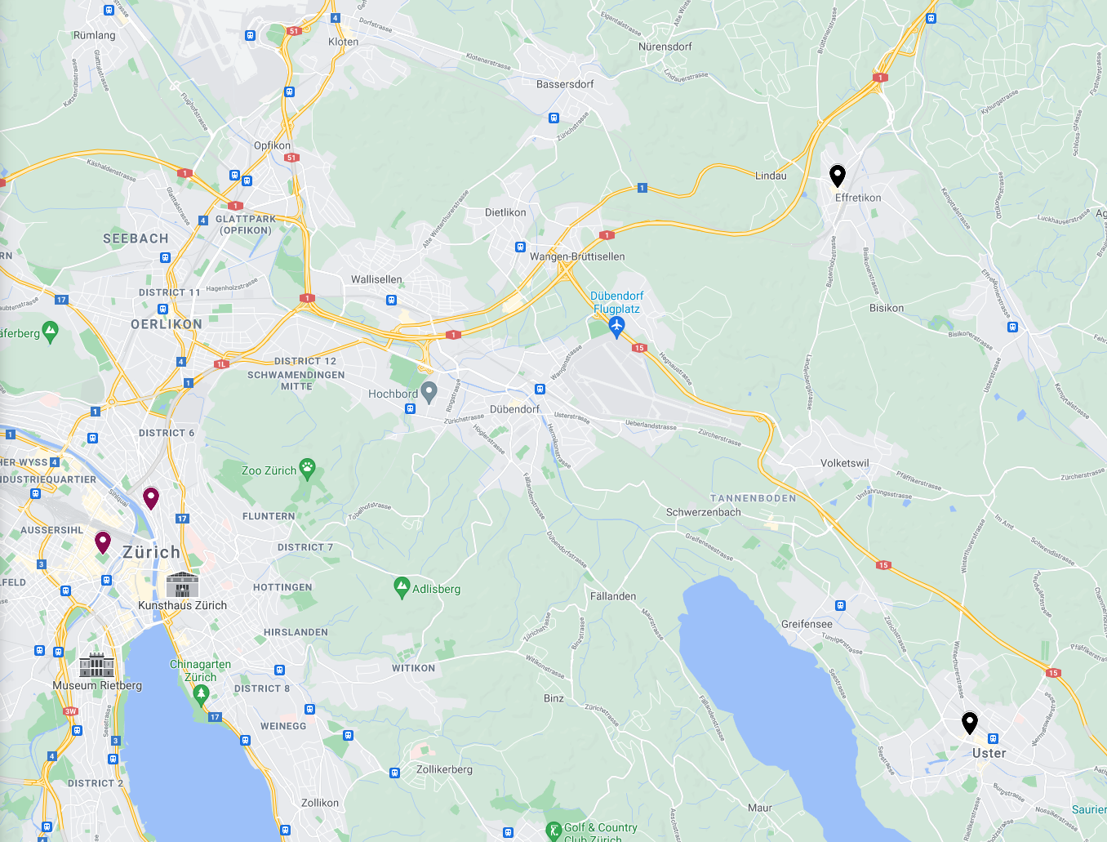
Caveats in our model
Locality of data
Quality of data
Quality of training
User expectations
Notes:
Whilst the stations used for our training data were in an heavily urban area, our sensors where in an semi-rural area.
The quality of the training could either be improved by training over much bigger dataset then we had at hand. Also we have not factored into the seasonal trends as we only measured the spring season.
User expectations.
User expectations. A user would expect the model to perform well on any day. Especially, if your a farmer you need to rely on correctness of weather models, because it is not good enough to have a small root-mean-square error, but also the trend needs always following the reality, otherwise you might loose your crops in a storm, whilst the model once in a year said sun.

Slide 20
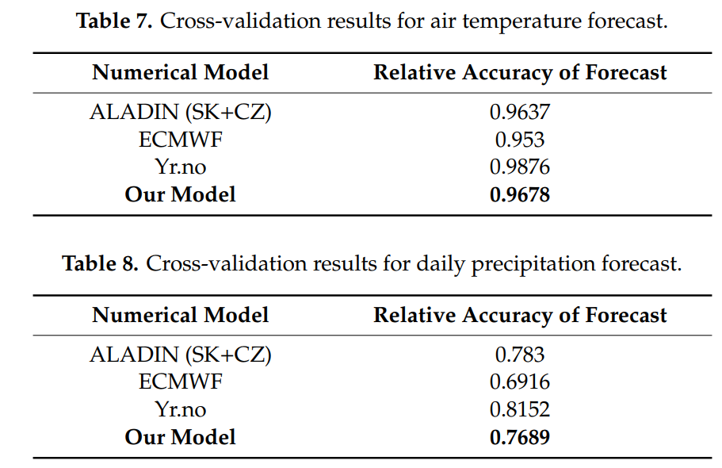
Results: Analysis of our model
Research going still both ways.
Machine learning already proven to work better in some situations.[8]
Implementation of more advanced models and techniques like clustering.[9][10]
Focus on anomaly detection in clusters.[11]
Paper’ s Model
Paper’ s Model

Slide 21
Further examination
Improve Accuracy
Additional sensors to understand weather conditions better
Further improving the prediction models
Improve Reach
Additional measurement stations
Improve Understanding
Urban environment versus Rural enivronment
Notes:
Adding additional sensors to measure weather more holistically, which is with our solution easily doable
Further sharpening the prediction models, maybe with better training data
We also propose to improve reach by adding more measurement stations, possibly compare countries
Last but not least, as we’ve shown the urban environment can have drastically different enivronment then rural, there is further investigation necessary to understand this disparity.

Slide 22
Sources
[1] en.wikipedia.org/wiki/Particulates
[2] fedlex.admin.ch
[3] Elminir, 2005
[4] Kayes, 2019
[5] nccs.admin.ch
[6] meteoswiss.admin.ch
[7] cosmo-model.org
[8] Frnda, 2019
[9] Mahajan, 2017
[10] Mahajan, 2018
[11] Chen, 2017

